Slide 1
Modeled estimates of HIV-serodifferent couples in tuberculosis-affected households in sub-Saharan Africa Meixin Zhang¹, Ashley S. Tseng², Godwin Anguzu³, Ruanne V. Barnabas⁴, J. Lucian Davis⁵, Andrew Mujugira⁶, Abraham D. Flaxman¹, Jennifer M. Ross⁷
¹Institute for Health Metrics and Evaluation, University of Washington, Seattle, USA; ²Department of Epidemiology, University of Washington, Seattle, USA; ³Department of Social Science Research Institute, Duke University, Durham, USA; ⁴Division of Infectious Diseases, Massachusetts General Hospital, Boston, USA; ⁵Department of Epidemiology of Microbial Diseases, Yale School of Public Health, New Haven, USA; ⁶Infectious Diseases Institute, Makerere University, Kampala, Uganda; ⁷Division of Allergy and Infectious Diseases, University of Washington, USA

Slide 2
Aims
Estimate
HIV status in TB-affected households
Within-household sexual partnerships
HIV acquisition can be averted through PrEP during household TB contact evaluation

Slide 3
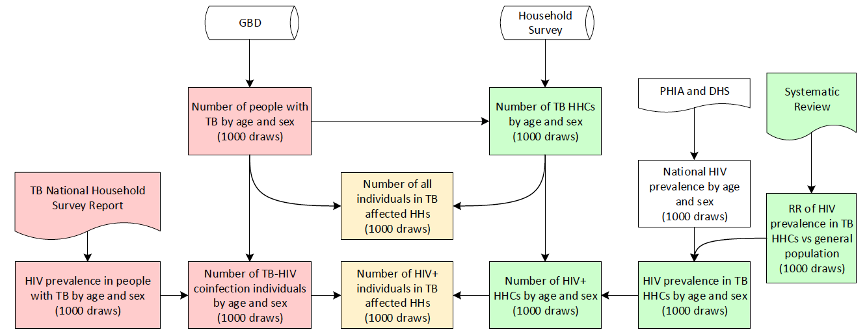
(A)
Figure 1. Flow diagrams of mathematical models used in this study. (A) Flow-chart depicting the process of obtaining the TB and HIV-TB coinfection situation in TB affected households. (B) Flow-chart depicting the process of generating the proportion of SDCs using outputs from (A).

Slide 4
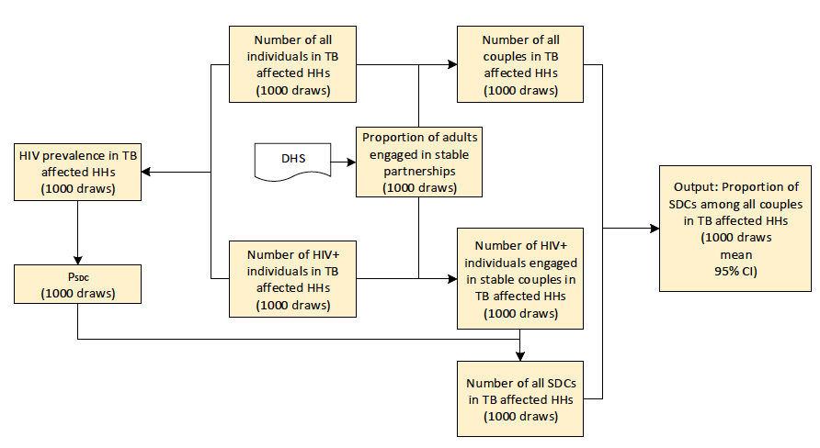
(B)
Figure 1. Flow diagrams of mathematical models used in this study. (A) Flow-chart depicting the process of obtaining the TB and HIV-TB coinfection situation in TB affected households. (B) Flow-chart depicting the process of generating the proportion of SDCs using outputs from (A).

Slide 5




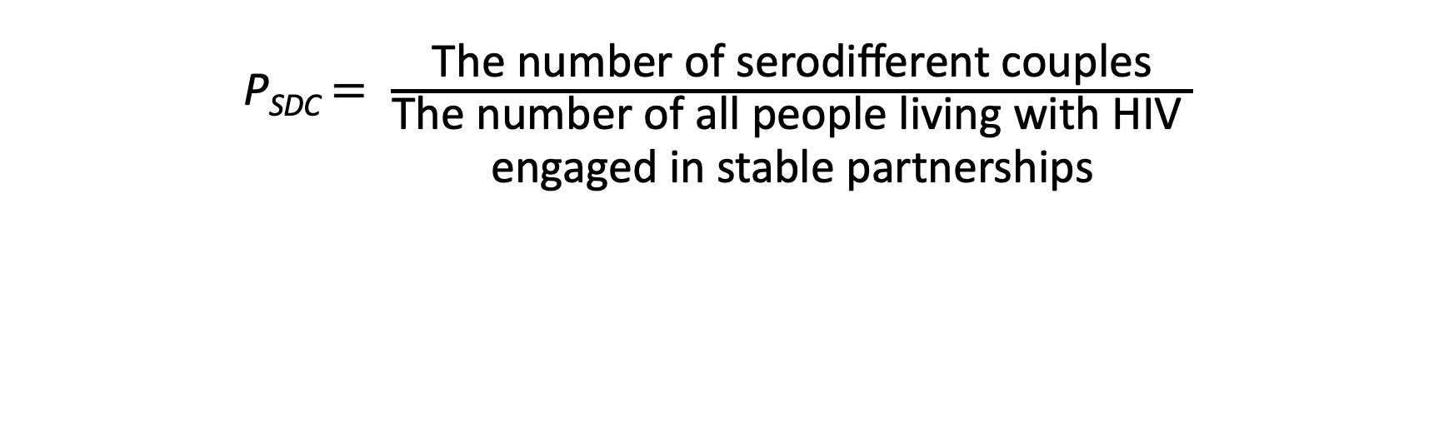
Parameter: P_{SCD}
Numerator: 2
Denominator: 4
P_{SDC}$= \frac{\text{T}\text{he} \text{number} \text{of} \text{serodifferent} \text{couples}}{\begin{aligned}\text{T}\text{he} \text{number} \text{of} \text{all} \text{people} \text{living} \text{with} \text{HIV} \\ \text{engaged} \text{in} \text{stable} \text{partnerships}\end{aligned}}$

Slide 6
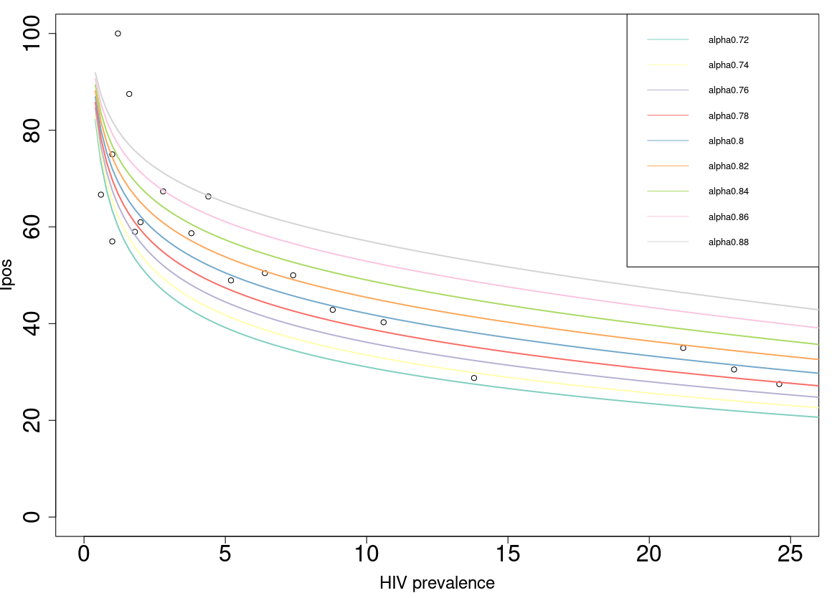

Relationship between P_{SCD} and HIV prevalence
$$P_{SDC}\left(P\right) ≅ \frac{{\left(P\left(1−P\right)\right)}^{α}}{P}$$

Slide 7
(B)
Figure 1. Flow diagrams of mathematical models used in this study. (A) Flow-chart depicting the process of obtaining the TB and HIV-TB coinfection situation in TB affected households. (B) Flow-chart depicting the process of generating the proportion of SDCs using outputs from (A).

Slide 9
Thank you!

